Slide 1

Transitivity
Transitivity is the key index of triadic structure
  Akin to Mathematical transitivity; relation R is transitive iff:
    aRb, and bRc jointly imply aRc
    Equality, Less than, Greater than, etc.
  Same reasoning applies to social relationships

Slide 2
Global measures of transitivity
A simple way to quantify the level of transitivity in a network is to think of as a probability
  In this case, it is the conditional probability that (for any three vertices u, w, v):
    If we observe the uw edge and the uv edge,
    We will also observe the wv edge
  Note that condition (i) defines a path of length 2
  So a way to quantify transitivity in the network is simply to:
    Count all of the paths of length two
    Determine how many of them are closed
    Divide the last quantity by the first

Slide 3
Global measures of transitivity
p = 0
t = 0
for (i = 1; i <= n; i++) {
for (j = 1; j <= n; j++) {
for (k = 1; k <= n; k++) {
if (A[i, j] == 1 & A[i, k] == 1) {
p++ /*increment two-path count*/
if (A[j, k] == 1) {
t++ /*increment triangle count*/
} /*close second if*/
} /*close first if*/
} /*close k loop*/
} /*close first if*/
} /*close j loop*/
} /*close i loop*/
C = (t * 6) / p /*(Newman 2010: 199, Eq. 7.40)*/

Slide 4
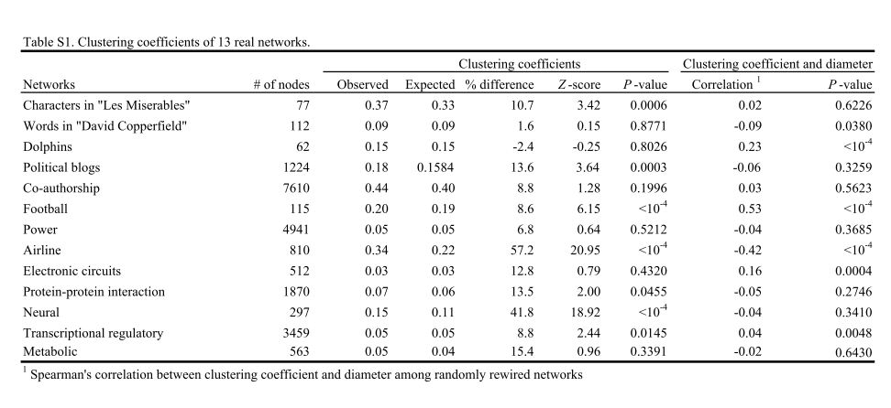
Global clustering coefficient in different networks

Slide 5

The Clustering Coefficient (Again)
One place to begin is with the simple clustering coefficient at the ego-network level:
Where g_{jk} = 1 if i's j^{th} neighbor is connected to her k^{th} neighbor, and k_{i} is i's total number of neighbors.

Slide 6

The (global) clustering coefficient
We can then characterize the global network structure by computing:
  The Average Clustering Coefficient
  Ascertaining the relationship between k_{i} and C(k_{i}) (vertex degree and the average clustering for vertices of degree k)
    Strong Negative dependence of C(k) on k may indicate that the network relies on hubs as connectors between disparate worlds.

Slide 7
Global measures of transitivity
G = J(n, 1, 0)
Ci = J(n, 1, 0)
D = rowsum(A)
for (i = 1; i <= n; i++) {
for (j = 1; j <= n; j++) {
for (k = 1; k <= n; k++) {
if (A[i, j] == 1 & A[i, k] == 1 & A[j, k] == 1) {
G[i, 1] = G[i, 1] + 1
} /*close if*/
} /*close k loop*/
} /*close j loop*/
Ci[i, 1] = G[i, 1] / (D[i, 1] * (D[i, 1] - 1))
} /*close i loop*/
C = rowsum(Ci) / n

Slide 8
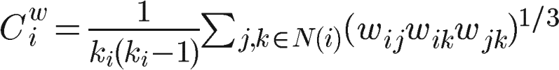
Generalization to Weighted Networks
There is no agreed upon way to generalize the clustering coefficient to weighted networks
  The most intuitive proposal is by Onnela et al (2005) who introduce the concept of triangle intensity
  The intensity of the triangle is then given by the geometric mean of the weights of the triangle centered on vertex i.

Slide 9

Generalization to Weighted Networks
Same approach can be used to come up with a generalization of the weighted clustering coefficient at the global level
  Decide on a method to compute the value of a triplet (a three-some of connected vertices), such as the geometric means of the weights
  Compute the value of all closed triplets
  Divide (a) by the value all triplets:

Slide 10
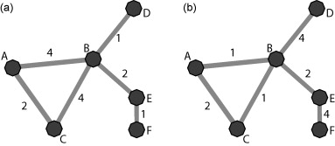
Generalization to Weighted Networks
C(a) = C(b) = 0.33
Cw(a) = 0.44
Cw(b) = 0.23

Slide 11
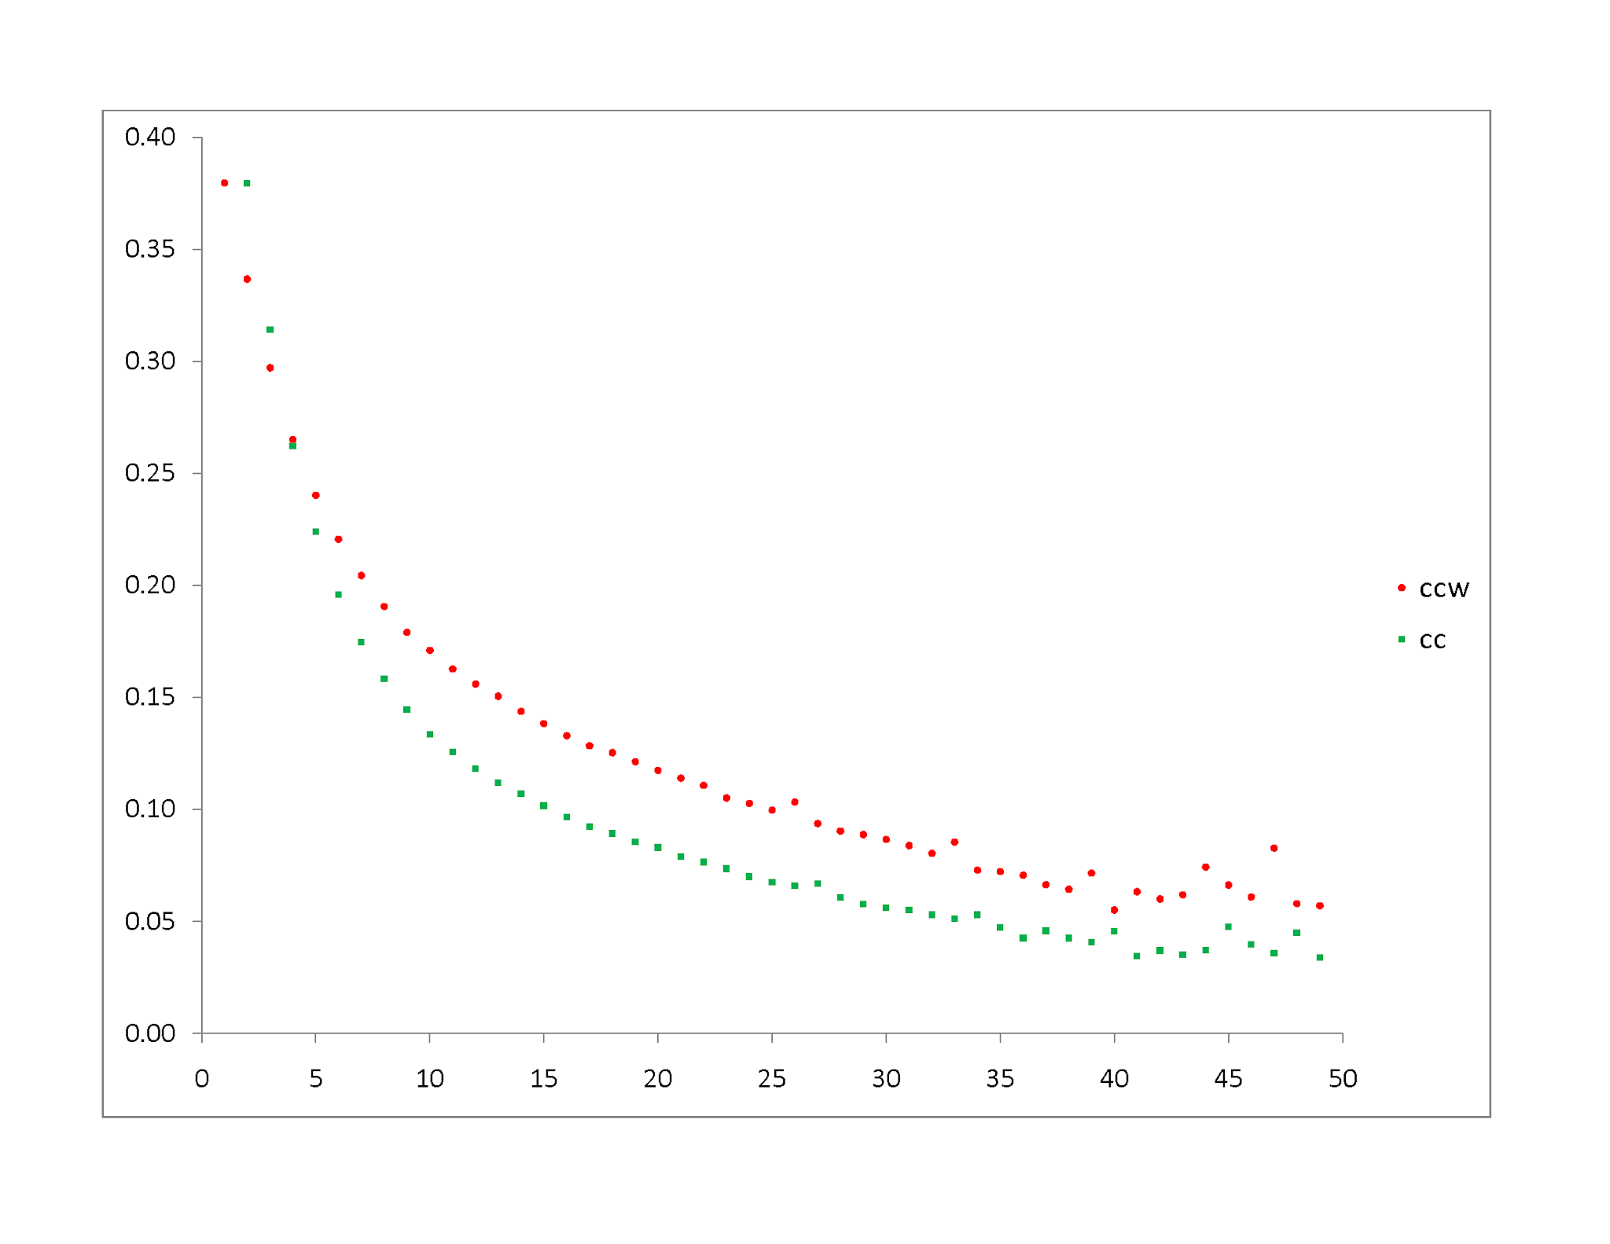

Slide 12
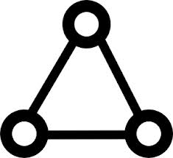

Edge Multiplicity
The degree dependent clustering coefficient is a vertex level index: The number of triangles (T_{i}) in which a vertex participates
We may ask the same question about a pair of vertices, defining an index of clustering for edges
The multiplicity of an edge m_{ij} can be defined as the number of triangles in which that edge participates.
The quantities are related as:

Slide 13
Edge Multiplicity
e = (n * (n - 1))
E = J(e, 3, 0)
z = 0
for (i = 1; i <= n; i++) {
for (j = 1; j <= n; j++) {
if (A[i, j] == 1) {
E[z, 1] = i
E[z, 2] = j
}
m = 0
for (k = 1; k <= n; k++) {
if (A[i, k] == 1 & A[j, k] == 1) {
m++ /*increment triangle counter*/
} /*close second if*/
E[z, 3] = m
} /*close k loop*/
} /*close first if*/
} /*close j loop*/
} /*close i loop*/

